Slide 1
Early Mathematics Education
Good morning, mathematicians
We will begin the session shortly.
As we settle in, please write 2 to 3 responses to complete this statement:
Geometry is………
Notes:
Introduce oneself

Slide 2
Reflective Practice
Turn and Talk about what happened when you did the shoe graph research lesson.
What did you notice that children said and did to show evidence of understanding or confusion?
Notes:
Introduce oneself

Slide 3

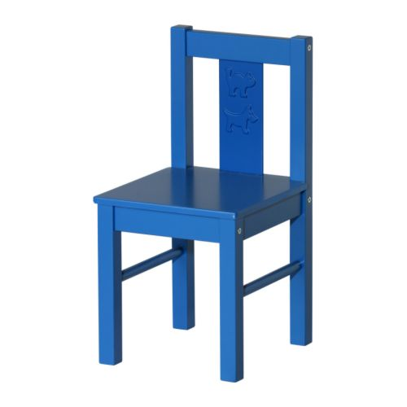
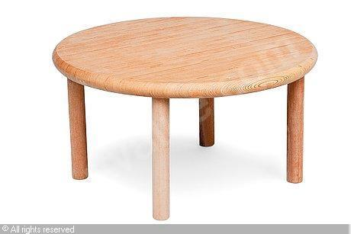
Let’s Do Math
Obstacle Course
Adult Learning Experience
Can you guess what math content we are focusing on today?

Slide 4
Learning Labs
2013-2014
Session |  | Topic
5 |  | Operations
6 |  | Measurement
7 |  | Data
8 |  | Geometry
Notes:
Introduce oneself

Slide 5
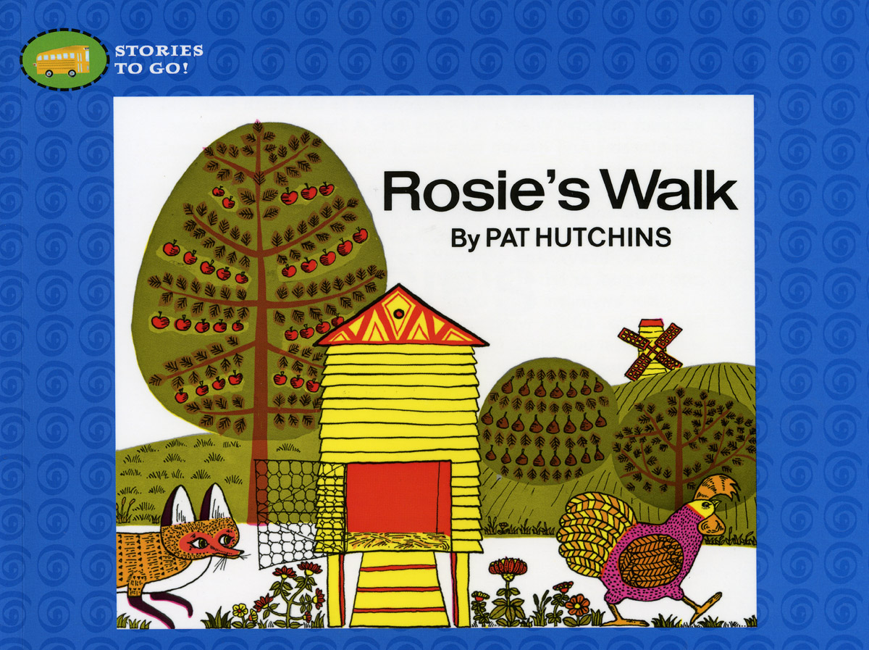
Featured Book

Slide 6
Let’s Talk about Math
  What’s the connection between the obstacle course, drawing Rosie’s path and spatial relationships?
  In what way are spatial relationships mathematical?
Notes:
Bid Ideas for the book
Counting can be used to find out how many;
counting has rules;
a quantity can be “broken apart,” and
the parts can be combined to form the whole.

Slide 7
Draw a Google map for Rosie’s walk
Work on your own, using the grid paper.
Rosie must follow a closed path that can be
Circular
Rectangular
Triangular

Slide 8
GPS for Rosie’s Walk
Find a partner from another table; do not show each other your maps during this activity, until the very end.
Partner A gives B verbal directions as B tries to draw A’s map on another grid paper. Then B gives A directions.
You may only use movement and direction terms.
Notes:
Bid Ideas for the book
Counting can be used to find out how many;
counting has rules;
a quantity can be “broken apart,” and
the parts can be combined to form the whole.

Slide 9
Let’s Talk About the Math
How well did the map you drew from the directions reflect the one your partner drew and described?
What did you or your partner do that might have made the task easier or more challenging?
Where is the math in the Rosie’s Walk activities?
Notes:
Bid Ideas for the book
Counting can be used to find out how many;
counting has rules;
a quantity can be “broken apart,” and
the parts can be combined to form the whole.

Slide 10
Let’s Talk About Geometry
Looking back at the Geometry is…. statements, how has your understanding changed?
How might these terms make sense?
Path—shape—perimeter
Defining mathematical attributes of shapes?
Notes:
Bid Ideas for the book
Counting can be used to find out how many;
counting has rules;
a quantity can be “broken apart,” and
the parts can be combined to form the whole.

Slide 11
Developmental Considerations
1) Movement in space is a basic and powerful experience that helps develop spatial sense.
Children need to
talk about,
plan,
organize such movements
Notes:
Bid Ideas for the book
Counting can be used to find out how many;
counting has rules;
a quantity can be “broken apart,” and
the parts can be combined to form the whole.

Slide 12
Developmental Considerations
2) Perspective-taking is just developing in many children of this age –
Provide many experiences to show
Things look different depending upon where the viewer is.
Words describe directions relative to a particular point of view
Positional words often come in opposites: over/under; up/down; left/right; near/far…
Notes:
Bid Ideas for the book
Counting can be used to find out how many;
counting has rules;
a quantity can be “broken apart,” and
the parts can be combined to form the whole.

Slide 13
Developmental Considerations
3) English language learners and children whose language is developing will need more support in understanding & using directional language, including
Use of child’s home language as much as possible
Use of gestures
Notes:
Bid Ideas for the book
Counting can be used to find out how many;
counting has rules;
a quantity can be “broken apart,” and
the parts can be combined to form the whole.

Slide 14
Spatial Relationships:
Big Ideas and Key Skills
Relationships between objects and places can be described with mathematical precision. | Naming: Accurate response to and use of positional words (e.g., over, under, around, right, left, etc) Expressing measurement in appropriate units (e.g., Go 3 steps forward; Your house is 2 blocks away from mine.) Recognizing and expressing difference in spatial relationships depending on relative position (e.g., the car is to your left and my right; When I look at the tree from far away it looks smaller than when I am close to it) Fluency in visualizing and manipulating spatial relationships (e.g., being able to mentally flip pieces to make them fit in a jigsaw puzzle).
Our own experiences of space and two-dimensional representations of space reflect a specific point of view
Spatial relationship can be visualized and manipulated mentally.

Slide 15
Research Lesson: Rosie’s Walk
WALK WITH ROSIE_PEARSON.wmv
How does the sequence of the activities support children to represent their understanding of spatial relationships in more than one way?
How does the teacher give ownership of the lesson to the children?
List the ways the teacher supports children’s language development?
What evidence do you see that children are engaged and are actively constructing their own understanding?

Slide 16
Let’s Get in Shape
Each of us will have a regular shape pinned on our back.
We go around asking yes and no questions about the mathematical attributes of the shape to others, trying to figure out what shape we have.
Mathematical Attributes include
Type of line (curved or straight)
Number of lines
Number and type of corners
Relationship between length or angles (all the same, 2 are equal, other(s) are not etc….

Slide 17
Shapes
Big Ideas | Key Skills
Shapes can be defined and classified by their attributes. | Naming: knows mathematical attributes include straight and/or curved lines, number of sides and angles (corners), and type of angles (square corner or not ) Noticing and Expressing measurement/comparison of shapes, including that sides of a shape may have different length or that 2 triangles can be same type but that one can have longer sides.
The flat faces of solid shapes(three dimensional shapes) are two dimensional shapes.
Shapes can be combined and separated (composed and decomposed) to make new shapes.

Slide 18
Research Lesson: Feeling for Shapes
feel_for_shapes.m4v
How does the mystery bag activity focus children’s attention on the defining attributes of shapes, rather than on shape names?
How does the teacher give ownership & support the children’s learning?
List the ways the teacher supports children’s language development?
What evidence do you see that children are engaged and are actively constructing their own understanding?

Slide 19

Reflecting on
Big Ideas of Early Mathematics

